Slide 1
Autonomous Cognitive Engine for Deep Research and Long-Horizon Tasks
Multi-Agent Research System using LangGraph & LangSmith
Presented by
Annam Lasya

Slide 2

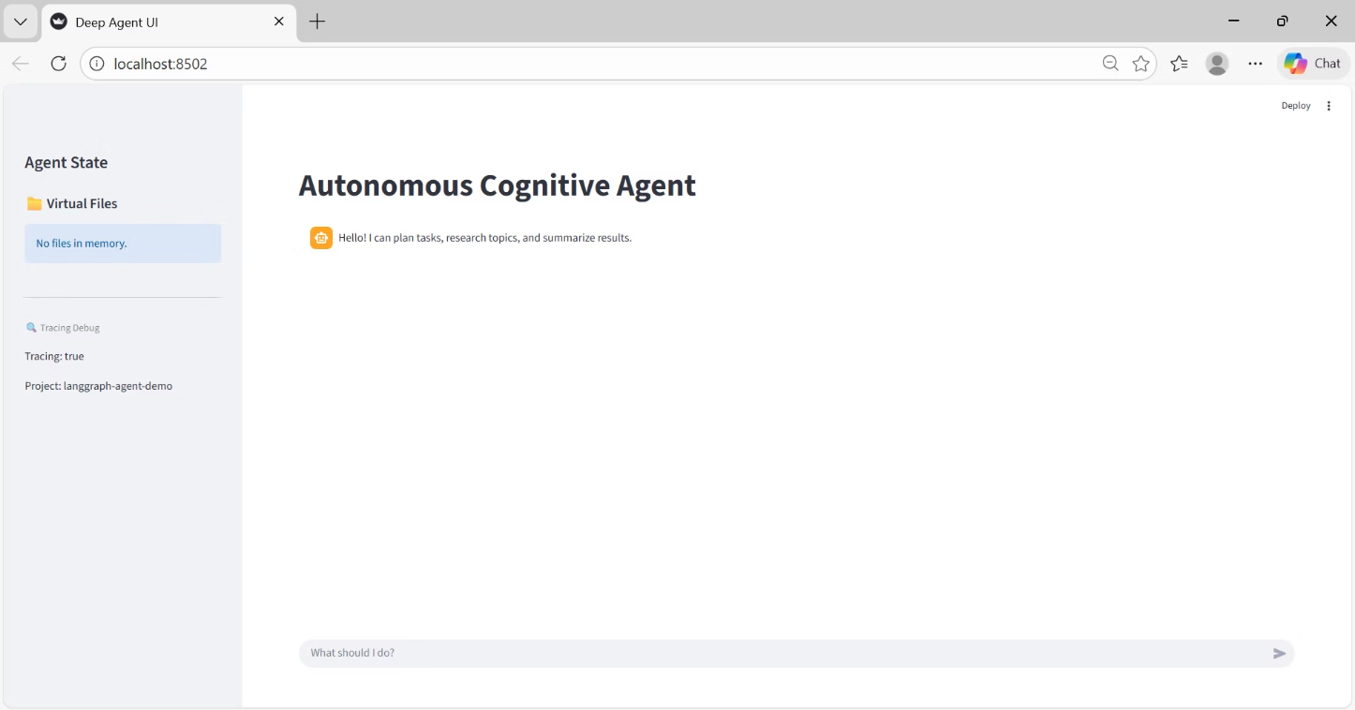
PROJECT OVERVIEW
Multi-Agent Research System
This project implements a multi-agent research system using:
LangGraph (state-driven execution)
LangChain (LLM orchestration)
LangSmith (tracing) Streamlit (UI)
Goal: Clear separation of planning, research, search, and summarization, while keeping internal reasoning hidden from UI and fully traceable.

Slide 3
CHALLENGE
The Problem with Traditional Agents
Single-agent design mixes planning, reasoning, and execution
Lack of observability → reasoning and tool usage are hidden
Difficult to debug or audit workflows
Poor handling of long-horizon tasks and complex dependencies
No structured memory for intermediate results
Key Takeaway: Traditional agents do not separate responsibilities, making them opaque, brittle, and hard to scale.

Slide 4
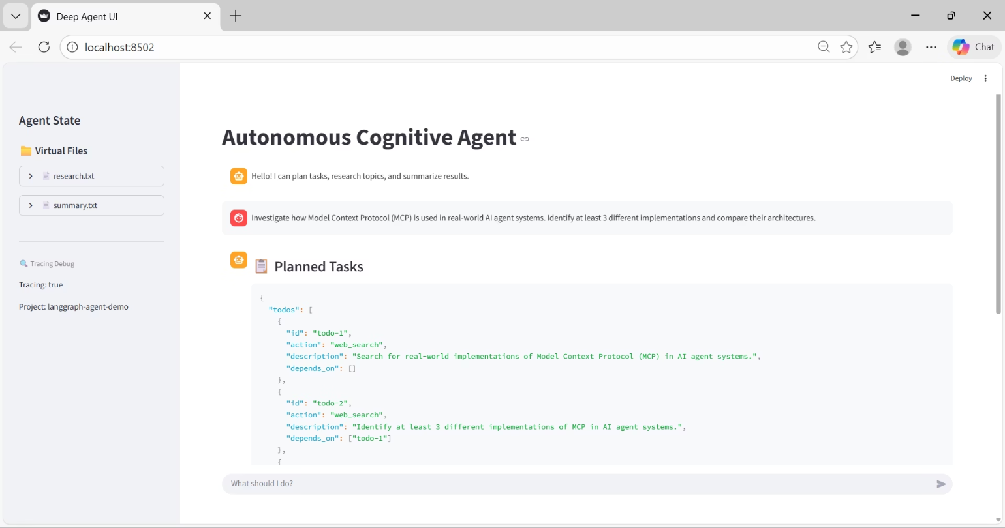
SOLUTION
A Modular Multi-Agent Approach
Multi-Agent DesignSpecialized agents (Planner, Research, Search, Summarizer) work together in a deterministic, state-driven system.
Role SeparationEach agent has a clear, independent responsibility.
Tool-Based ExecutionAll actions use traceable tools, artifacts are stored in VFS, and LangSmith logs every step.

Slide 5
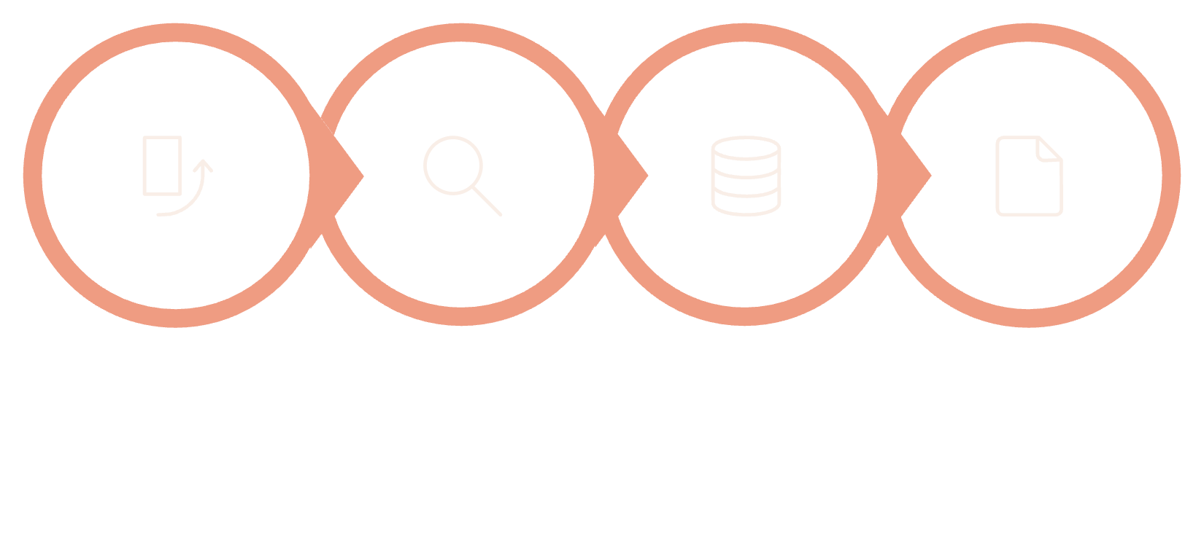
ARCHITECTURE
System Architecture & Flow
Execution Flow
User query → Planner TODOs
Research agent orchestrates tools
Search agent performs web search
Summarizer generates final output
Results stored in VFS, shown in UI
Planner
Research
Search
Summarizer

Slide 6
Key Features & Capabilities
Planner Agent: Converts user queries into structured TODOs for controlled execution
Search & Research Agents: Parallel information retrieval and tool coordination
Summarizer Agent: Generates coherent final summaries
Virtual File System (VFS): Shared memory for intermediate and final outputs
LangSmith Tracing: Full observability of agent decisions, tool calls, and state transitions
Streamlit UI: Clean interface showing only results and sidebar files

Slide 7
Technology Stack & Tools
Tavily Search APIProvides enterprise-grade web search with semantic ranking, enabling accurate and relevant research results.
OpenRouter LLMOffers a single gateway to multiple large language models, allowing flexible model selection and execution.
Traceable ToolsAll agent actions and tool calls are fully logged, ensuring transparency, observability, and easy debugging.

Slide 8
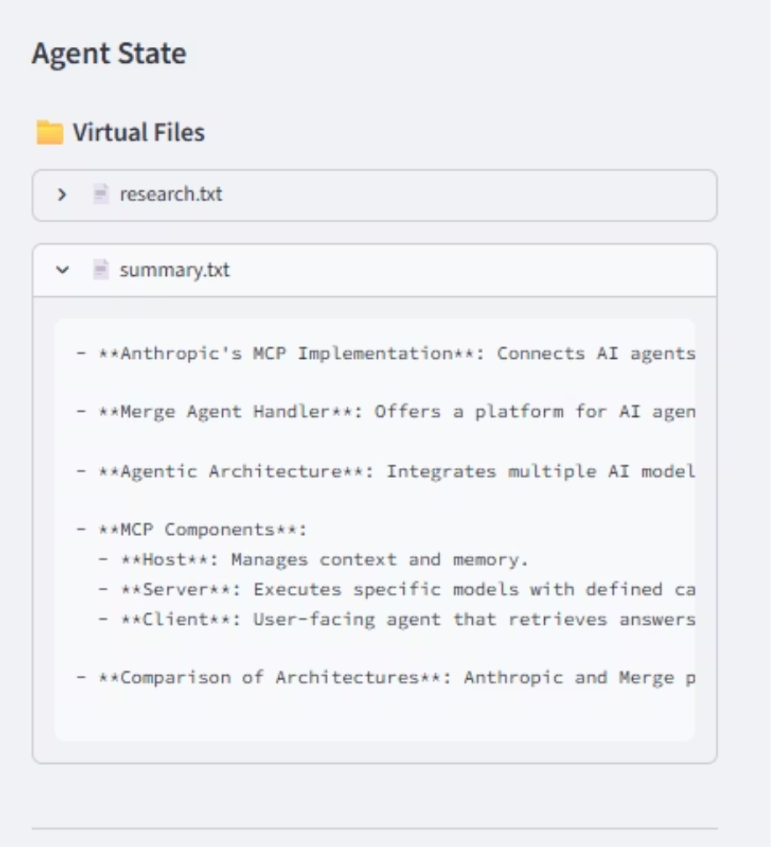
VFS ARCHITECTURE
Virtual File System Design
Shared Agent Memory
todos.json Structure
Centralised state repository enabling seamless data exchange between autonomous agents
Structured task management with status tracking, dependencies, and priority queuing
summary.md Output
Markdown-formatted final deliverable containing synthesised research findings and insights

Slide 9
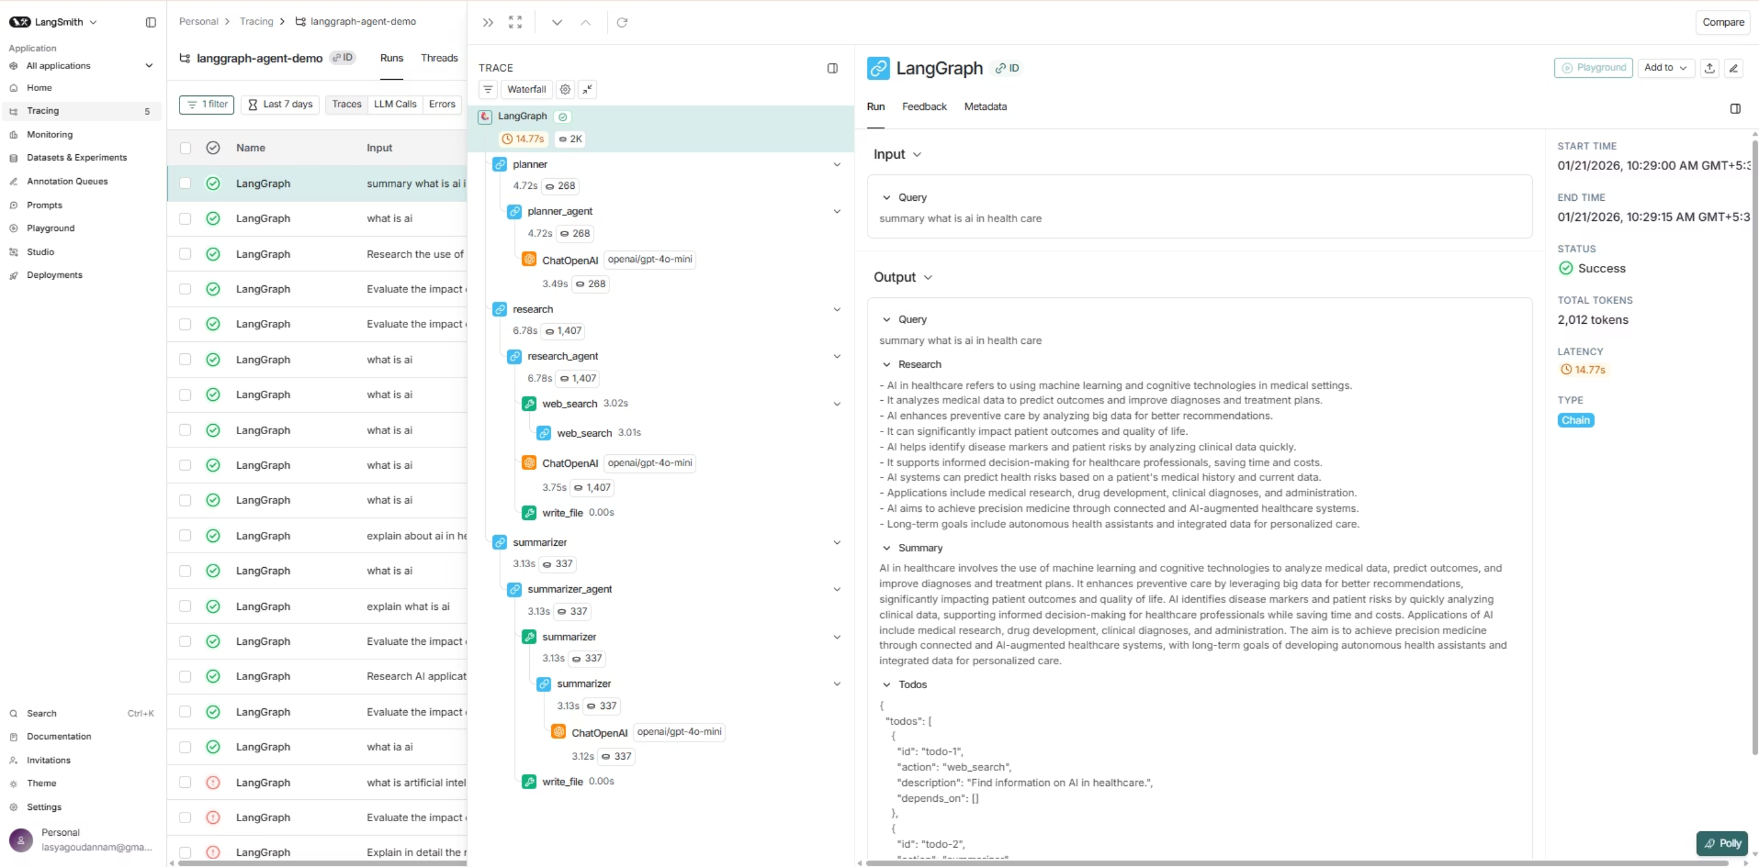
OBSERVABILITY
LangSmith Tracing & Monitoring
LangSmith provides production-grade tracing, enabling rapid debugging, performance optimisation, and continuous improvement of agent behaviours.

Slide 10
Challenges And Future Scope
Challenges
Future Scope
Coordinating multiple agents smoothly
Fully autonomous task execution
Maintaining consistent shared state
Integrate more AI models
Mapping tasks to correct tools
Personalized user workflows
Debugging & tracing agent actions
Automatic data visualizations
Handling concurrent requests
Multi-language & cloud support

Slide 11
THANK YOU…

Slide 12
Q/A

